Slide 1
An Introduction to the R Programming Language
Lesson 7
Visualizing Data

Slide 2
Goals
Appreciate the importance of visualization for understanding data
Learn how to use ggplot2 to visualize data
Objectives
Know the 3-step approach to make any kind of graph
Define “aesthetic” and explain how aesthetic mappings relate variables of a data frame to graphic markings on a graph
Define “geom” and explain how geom functions create layers of a graph
Distinguish between setting vs mapping aesthetics
Distinguish between global vs local settings

Slide 3
Your Turn 1
Consider the orders data frame. How do you think order_time and result_time are related to each other?
Pair up and discuss.
Notes:
Let’s start with an exercise. (read)

Slide 4
Your Turn 2
Type the following code in the console to make a graph.
Pay attention to the spelling, capitalization, and parentheses!
ggplot(data = orders) +
geom_point(mapping = aes(x = order_time, y = result_time))

Slide 5
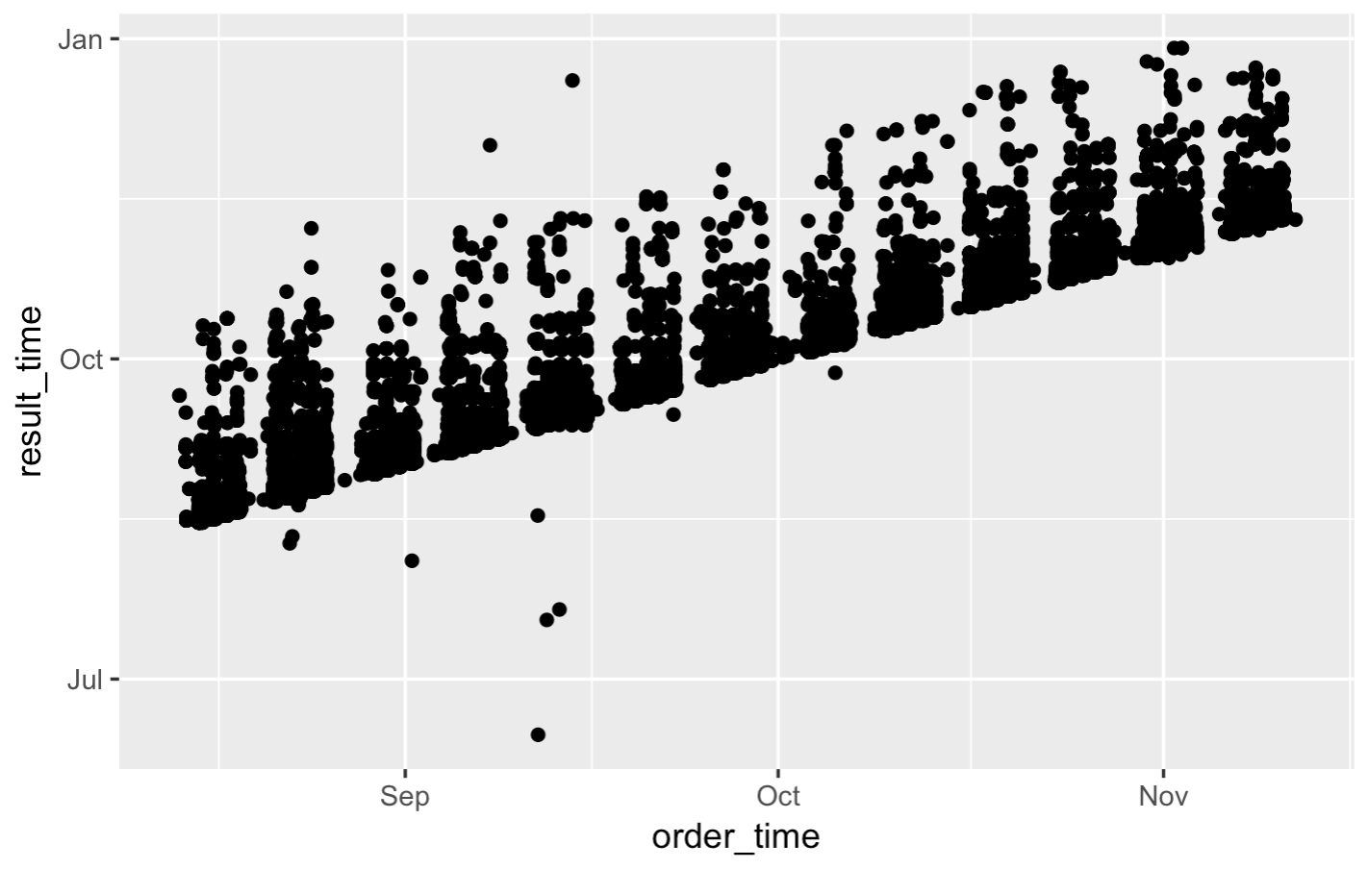
ggplot(data = orders) +
geom_point(mapping = aes(x = order_time, y = result_time))
Notes:
You might have expected that there’s a linear relationship, which is actually true in aggregate - but this simple visualization reveals so much more than that.
We see 13 equally sized clusters of data.
Each cluster has a clearly marked bottom along a slope, with lots of points plotted on top of each other. The slope appears to be along the line where result time is equal to or very close to order time.
There are a couple of dots below that line, suggesting some orders were resulted before they were ordered.
None of this would be apparent from looking at a table with 45,000 rows.
The point of this exercise is that you might have some ideas about your data, but often times those ideas are wrong or incomplete. Being able to visualize data quickly is critical for understanding.
Delete from PDF deck

Slide 6

When you run this code, you will get what looks like an error but is actually just a message. R lets you know that some of the rows did not have data for order_time and/or result_time so those points were not plotted.
ggplot(data = orders) +
geom_point(mapping = aes(x = order_time, y = result_time))
Notes:
One quick notes about this warning.
This is a useful warning since it’s good to be aware of NAs in your dataset.

Slide 7
Notes:
We’ll be using the ggplot2 package for creating graphics. ggplot2 is part of the tidyverse so it will get loaded when you load the tidyverse package.
GGplot provides a "grammar of graphics" for data visualization. The idea is that you can build any type of graph by specifying the data, a the type of graph, and a mapping that describes how the data should be represented as visual marks on that graph.
So there should be a consistent way, or a grammar, to construct any type of graph.
The advantage of ggplot2 over other graphics packages for R is this consistent grammar, which makes it easy to generate a lot of different graphs quickly to help your understand your data. So that means that when you’ve learned how to make a scatterplot you don’t have to learn a totally new way to make a histogram, or some other kind of graph.
In addition, ggplot2 graphs are aesthetically pleasing and can be used to generate publication-quality plots.

Slide 8
ggplot()
+ sign
before new line
initialize a plot
with ggplot()
data frame
ggplot(data = orders) +
geom_point(mapping = aes(x = order_time, y = result_time))
mappings inside
aes() function
type of layer
x variable
y variable
Notes:
So here a quick breakdown of how we just used ggplot to make that graph.
You can see that we give it a data frame, in this case, our orders data
We specify the type of graph, or “geom”, in this case, a histogram
And we specify an aesthetic mapping, in this case, saying that we want the x axis to represent the order_time and the y axis to represent the result_time.
A few more details to note: you always start a plot with the ggplot() function
To connect the ggplot function to the geom function you use a ‘+’ sign which should be put at the end of the line, followed by a newline.
And the mappings need to go into the aes() function. Aes is for “aesthetic mapping” which we’ll define in a few minutes.

Slide 9
To make any kind of graph:
1. Choose a “tidy”
data frame
ggplot(data = data_frame) +
geom_function(mapping = aes(mappings))
2. Pick a “geom” function
3. Write aesthetic mappings
Notes:
So that was a lot of information. Let’s try to break it down further into a mental model. Here’s a template for making any kind of graph with ggplot2.
You start with the code written in black and fill in the details written in blue.
Pick a tidy data frame
Choose a geom function
Write aesthetic mappings

Slide 10
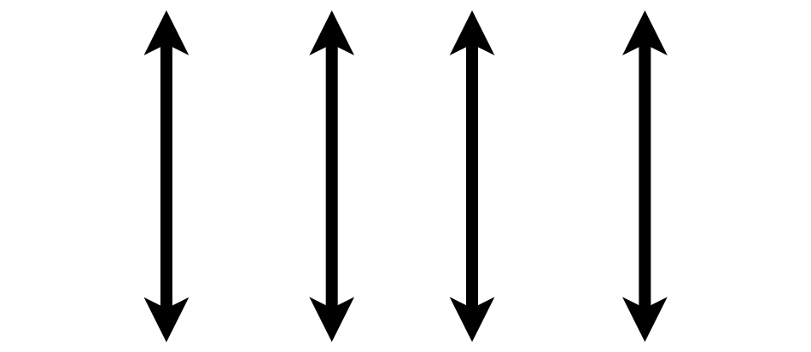
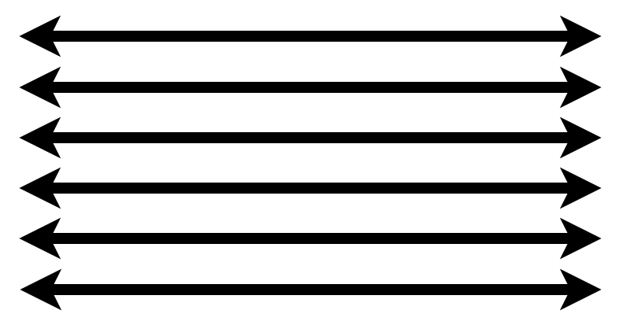
1. Pick a “Tidy” Data Frame
A data set is tidy if:
Each variable is in its own column
Each observation is in its own row
Each value is in its own cell
Notes:
This is a good time to review the idea of ”tidy” data that also gives the “tidyverse” its name.
Any data set can take on a lot of different shapes. But there is one shape that is best suited for data analysis, and that shape is called ”tidy.”
The opposite of “tidy” data is often called “messy” and often times one of the first data analysis tasks is to convert “messy” data into “tidy data.”
A data set is tidy if: each variable is in its own column,
Each observation is in its own row
Each value is in its own cell
Fortunately for us, the orders data set is tidy already.

Slide 11
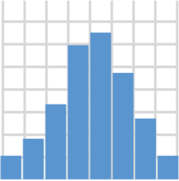
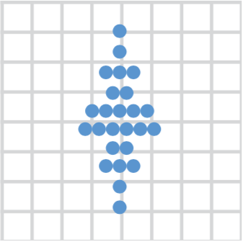
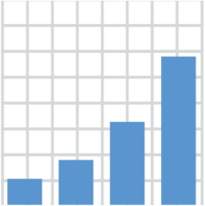

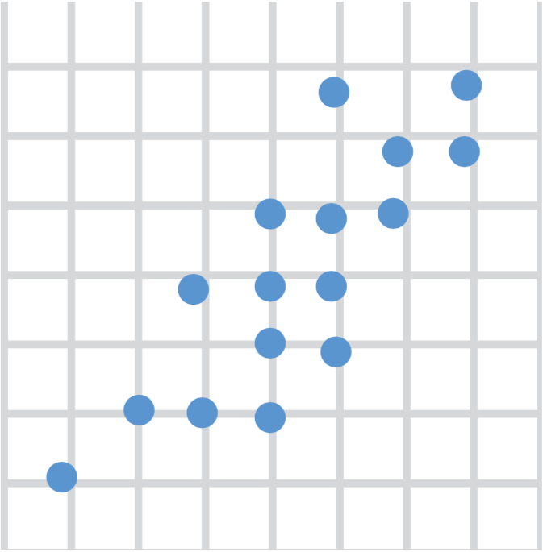
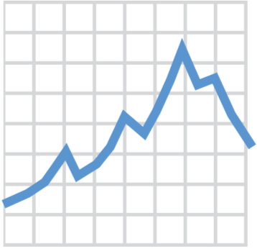
2. Choose a “Geom” Function
geom_histogram()
geom_dotplot()
geom_bar()
geom_boxplot()
geom_point()
geom_line()
Notes:
We’ll go into more detail about what geom functions are, but for now, just know that you need to tell ggplot what type of graph you want, and you do that by picking the right geom_ function.
Here are a couple of useful geom functions for visualizing clinical data, but there are many more. With these 6 you can make histograms, bar plots, scatter plots, dot plots, boxplots, and line graphs.

Slide 12
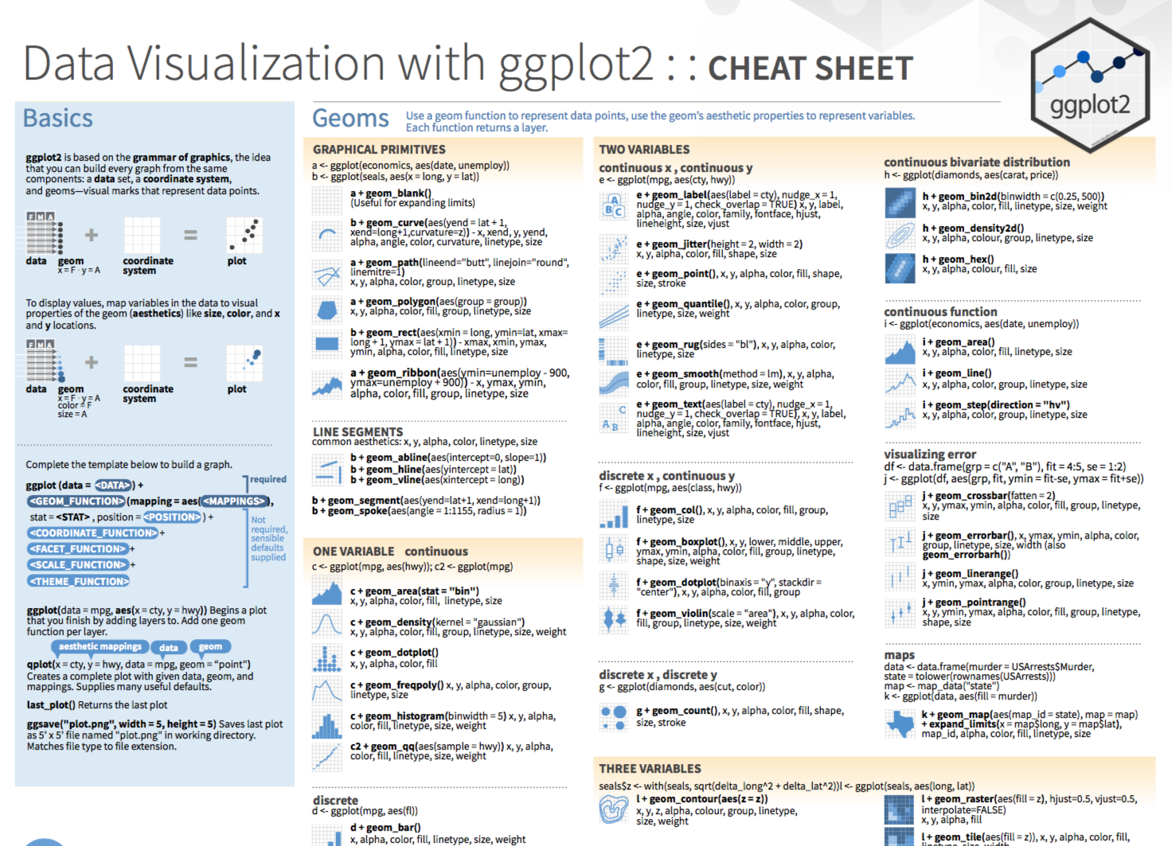
Notes:
The ggplot2 Cheat Sheet which is one of the loose leafs in your course pack is great to have on hand as you’re exploring your data with ggplot.

Slide 13
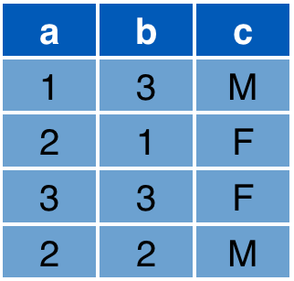

3. Write Aesthetic Mappings
aes(x = a, y = b, color = c)
Data frame
Graph
y
x
Notes:
So now we've picked a tidy data frame, we've picked a geom function, what's left now is to write aesthetic mappings.
So what's an aesthetic mapping? An aesthetic mapping is a definition of how you want the variables of your data frame represented as graphical markings on your plot.
For example, consider this data frame with 3 variables: a, b, c, and this 2D graph with an x and y axis.
* The aesthetic mapping above defines that x axis value of each marking should come from the "a" column
The y axis value from the "b" column
And since we’re now out of axes, we can define that the color should come from the "c" column. R figures out a reasonable color scale but you can fine tune this.
As a result, you get the expected graph.

Slide 14
Aesthetics
From Fundamentals of Data Visualization, by Claus Wilke, licensed under CC-BY-NC-ND
Notes:
Let’s take a closer look at aesthetics. Here are some very commonly used ones – position, shape, size, color, line width, or line type. Every graphical element of course has a position, which describes where the element is located, usually on the x and y axis. Data points displayed as dots have a shape, a size which can be used to encode data. Every graphical data element has a color. Line graphs have line widths and line types.

Slide 15
Your Turn 3
Consider the 6 aesthetics shown just previously. All aesthetics can be used for discrete variables, but only some can be used for continuous variables.
Which aesthetics can be used only for discrete variables?
Color
Line type
Shape
B + C
A + B + C
Notes:
Now let’s think about this for a second.
Correct answer: D
Color – can be continuous gradients, like for examples in gene expression heatmaps
(If cts vs discrete are not clear, review orders dataset)

Slide 16
Your Turn 4
Open 07-visualize.Rmd. Work through the exercises of the section titled “Your Turn 4.”

Slide 17
Setting vs Mapping Aesthetics
Notes:
Let’s spend the next few minutes on an important conceptual distinction about how you can define aesthetics in your plot.

Slide 18
How would you make this plot?
Notes:
Consider this plot. It’s the same as the one you’ve created at the beginning of the session, except the dots are blue, not black. So the difference is the color aesthetic. But we’re not really mapping the color aesthetic to a variable here, because all plots are the same color. They don’t represent the values of a variable of a data frame. Instead, we’re setting it to a constant value, the color blue. Let’s look at how this is done.

Slide 19
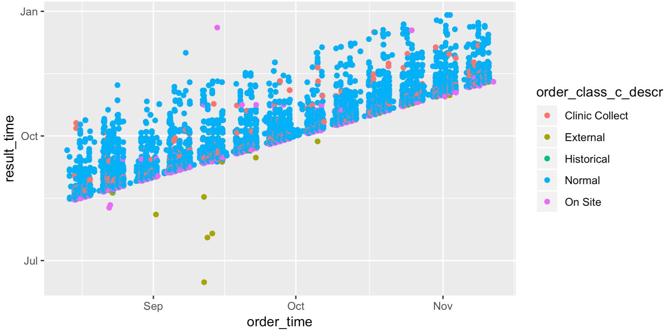
Inside of aes():
map an aesthetic to a variable
ggplot(data = orders) +
geom_point(mapping = aes(x = order_time, y = result_time, color = order_class_c_descr))
Notes:
In the exercise you just mapped the color aesthetic to the order_class_c_descr variable, by adding ”color = order_class_c_descr” to the list of definitions inside the aes function, highlighted here in red.
The general rule is: if an aesthetic is defined inside of the aes function then that aesthetic gets mapped to a variable.

Slide 20
Outside of aes():
set an aesthetic to a value
color name in “quotes”
ggplot(data = orders) +
geom_point(mapping = aes(x = order_time, y = result_time), color = "blue")
Notes:
If the aesthetic is defined outside of the aes function (but still inside of the geom function) – then it’s set to a constant value, like “blue”. R knows a lot of different colors by their English name.
*
Color names need to be put into quotes.

Slide 21
ggplot(data = orders) +
geom_point(mapping = aes(x = order_time, y = result_time, color = order_class_c_descr))
ggplot(data = orders) +
geom_point(mapping = aes(x = order_time, y = result_time), color = "blue")
Notes:
So to look at this one more time in one place:
If you define an aesthetic inside aes() -> aesthetic gets mapped to a variable of the data frame
If you define an aesthetic outside aes() -> aesthetic gets set to constant value

Slide 22
Geom Functions
Notes:
We’ve briefly looked at geom_ functions earlier and you might now appreciate how that makes it so easy to switch out one type of graph for another. But let’s dive a bit deeper into the concept of geom functions.

Slide 23
How are these plots similar?
Same: x axis, y axis, data
Notes:
Consider these two plots. How are they similar?
* The x axis is the same, order_time,
* and the y axis as well, result_time.
* Actually, the underlying data is the same as well.

Slide 24
How are these plots different?
Different geometric object (“geom”) used to represent the data
Notes:
What’s different is that on the left, the data is shown as a scatterplot, and on the right, it’s shown as a hex bin plot.
* So a geom function is a function that, given the data, and aesthetic mappings, generates the geometric object used to represent the data.

Slide 25
ggplot(data = data_frame) +
geom_function(mapping = aes(mappings))

Slide 26
Your Turn 5
Open 07-visualize.Rmd. Work through the exercises of the section titled “Your Turn 5.”
Notes:
Let’s do another quick exercise.

Slide 27
Global vs Local Settings
Notes:
One last fundamental idea in ggplotting is the distinction between global settings that apply to all parts of a ggplot - and local settings that only apply to a specific geom function.

Slide 28
Inside of geom_ function: apply locally to only the current layer
Inside of ggplot(): apply globally to every layer
ggplot(data = orders) +
geom_point(mapping = aes(x = order_time, y = result_time)) +
geom_smooth(mapping = aes(x = order_time, y = result_time))
ggplot(data = orders, mapping = aes(x = order_time, y = result_time)) +
geom_point() +
geom_smooth()
empty ()
Notes:
Take a look at the code from the last exercise, which I’ve reproduced here on the slide. We are plotting the orders data frame, and there are two geoms: the first is a scatterplot defined by geom_point. And the second is a smoothened conditional mean defined by geom_smooth. But look at the mappings. They are identical. This is actually a common scenario so it would be nice if you could define mappings globally for all parts of your plot.
Turns out you can. You can move the mapping argument inside the ggplot() function, and it will apply globally to every layer.
Notice how geom_point and geom_smooth now both have empty parentheses. That’s because now both the data and the mapping are defined globally in the ggplot function.
And importantly, if you have the same aesthetic set both globally and locally, the local setting overrides the global setting.

Slide 29
How would you make this plot?
ggplot(data = orders, mapping = aes(x = order_time, y = result_time)) +
geom_point(mapping = aes(color = order_class_c_descr)) +
geom_smooth(color = "black")
Notes:
Let’s look at a final example to review global vs local definitions and setting vs mapping.
How would you make this plot?
Looks like we have 2 geoms – a scatterplot and a smoothed mean, both with the same underlying data – so the data should be defined globally by writing data = orders in the ggplot() function.
The x and y mappings are the same for each geom, so we can make these two mappings global as well.
But the color aesthetic is different in the two geom functions. In the scatterplot color maps to order_class_c_descr; and for the smoothed mean, color isn’t mapped to a variable but is set to black. So color should be defined locally. For geom_point, it should be inside of the aes function because we’re mapping it to a variable; and for geom_smooth, it should not be inside an aes function because we’re just setting it to black.

Slide 30
What Else?
Notes:
In this last part of this session, I want to show a few additional things you can do with ggplot, without going into much detail.

Slide 31
Notes:
To save a plot you’ve created in the console, you can go to the Plots pane on the bottom right of the RStudio window, click export, and select Save as Image.
To save a plot you’ve created in a R notebook, you can right-click and select “Save image as”

Slide 32
Notes:
Ggplots are very flexible. You can adjust the position of objects…

Slide 33
Notes:
You can use different themes which affect how non-data elements such as axes, gridlines, and background appear.

Slide 34
Notes:
You can customize color scales.

Slide 35
Notes:
Facets are a way to break down a plot into sub-plots by a grouping variable, for example gender or location in the hospital.

Slide 36
Notes:
Ggplots also allow plotting in radial coordinates or on geographical maps.

Slide 37
Notes:
And of course you can add titles and captions.

Slide 38
ggplot(data = data_frame) +
geom_function(mapping = aes(mappings)) +
theme_function +
scale_function +
facet_function +
coordinate_function +
...
Required
Optional
Notes:
All of these elements, like themes, color scales, facets, coordinate systems, and text can be added to a ggplot command in the same way that we added geom layers – by writing a plus sign followed by a theme function, a scale function, a facet function, etc. You can find out about these functions on the Data Visualization Cheat Sheet.

Slide 39
Goals
Appreciate the importance of visualization for understanding data
Learn how to use ggplot2 to visualize data
Objectives
Know the 3-step approach to make any kind of graph
Define “aesthetic” and explain how aesthetic mappings relate variables of a data frame to graphic markings on a graph
Define “geom” and explain how geom functions create layers of a graph
Distinguish between setting vs mapping aesthetics
Distinguish between global vs local settings

